Slide 1


PHISH SCAN
Spot the Phish, Stay Secure!
RESEARCH INTERNS:
- Odapalli Keerthana
Sunkari Praneeth Narayan
Ch Nishitha Reddy
Shanmukhi
Vanshika
T Deekshita Reddy
PRINCIPAL INVESTIGATOR:
- Sai Kumar Tannyala

Slide 2


Phishing
WHAT IS PHISHING?
Phishing is a cyber attack method where attackers deceive individuals into providing sensitive information.
This information involves login credentials, financial details, or personal data, by posing as trustworthy entities.
The goal is to gain unauthorized access to accounts, steal identities, or commit financial fraud.
Phishing attacks are executed through various means which includes emails, websites(URL).

Slide 3

Phishing
WHY IS PHISHING DETECTION IMPORTANT?
With advent of AI attackers can create highly convincing phishing attempts, making detection more critical.
Detecting phishing is essential to prevent data breaches and protect sensitive information.
It maintains trust and reputation, safeguards financial assets from fraud, helps avoid identity theft and other cyber threats.
Early detection is key to mitigating potential damages and ensuring overall cybersecurity.

Slide 4
Market Analysis
Technologies
Need
Integrating advanced technologies like artificial intelligence (AI) and machine learning (ML) offers substantial opportunities by enhancing threat detection, accuracy in identifying phishing attempts, and providing adaptive defenses.
01
The increasing frequency and sophistication of phishing attacks drive the demand for advanced phishing protection solutions
06
02
Growth rate
Why?
CAGR of 11-13% over the course of the 10 years
Protect Sensitive Information, Financial Security, Maintain Reputation
05
03
Target
Significant market size
Individual Users, Corporate Employees, Businesses, Large Corporations.
04
An anticipated USD 3.6 billion in 2024 to USD 7.5 billion by 2028

Slide 5

Problem Statement
Develop a robust phishing detection system capable of identifying AI-driven phishing attacks.
AI-driven phishing detection systems that can accurately identify and mitigate phishing attempts in real-time.
Providing users with immediate feedback on email legitimacy while maintaining high detection accuracy and performance.

Slide 6
Existing Approaches
Literature Survey
Using ML
Detecting Phishing Domains Using Machine Learning
By Shouq Alnemari and Majid Alshammari
Spam Email Detection Using Deep Learning Techniques
By Isra AbdulNabi, Qussai Yaseen
Using DL
The extracted features are used to train machine learning models such as Decision Trees, Random Forests, Support Vector Machines (SVMs).
The extracted features are used to train machine learning models such as RNNs, CNNs, LSTM.
100%
A Deep Learning-Based Phishing Detection System Using CNN,LSTM, and LSTM-CNN
By Zainab, Rabeah, Jalal, Qazi, Kashif Saleem, Muhammad
Detection of URL based Phishing Attacks using Machine Learning
By Ms.Sophiya, Dr. S. D. Sawarkart, Mrs. Swati
Machine learning and deep learning for phishing email classification using one-hot encoding
By Bagui, Sikha; Nandi, Debarghya; Bagui, Subhash

Slide 7

Existing Approaches
Through DL
Patents
Using Transformers
Using ML

Slide 8
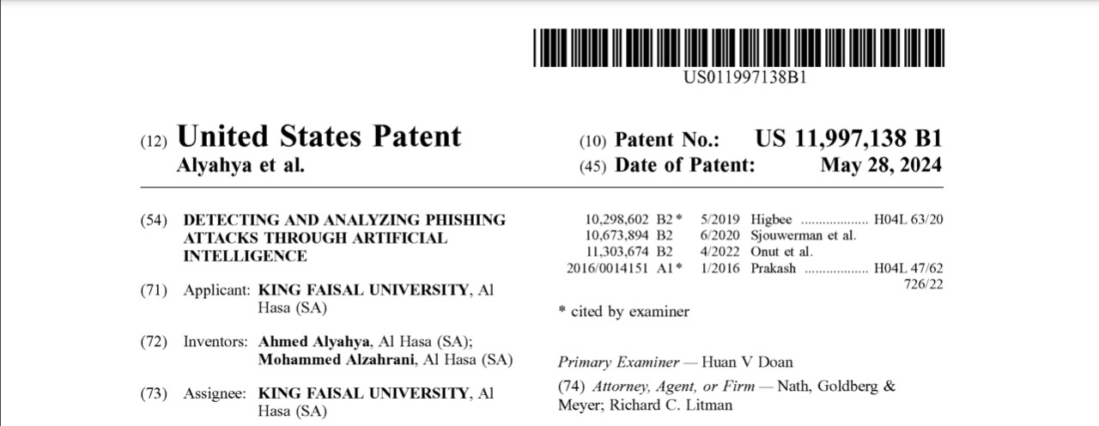
Patents
THROUGH DL
Patent No.: US11997138B1
Patent Title: DETECTING AND ANALYZING PHISHING ATTACKS THROUGH ARTIFICIAL INTELLIGENCE
Source: https://ppubs.uspto.gov/dirsearch-public/print/downloadPdf/11997138
Methodology:
Classifies phishing messages using pattern matching & common signs
It classifies messages into low ,high & moderate risk severity and alerts users
Uses RNN + BERT

Slide 9
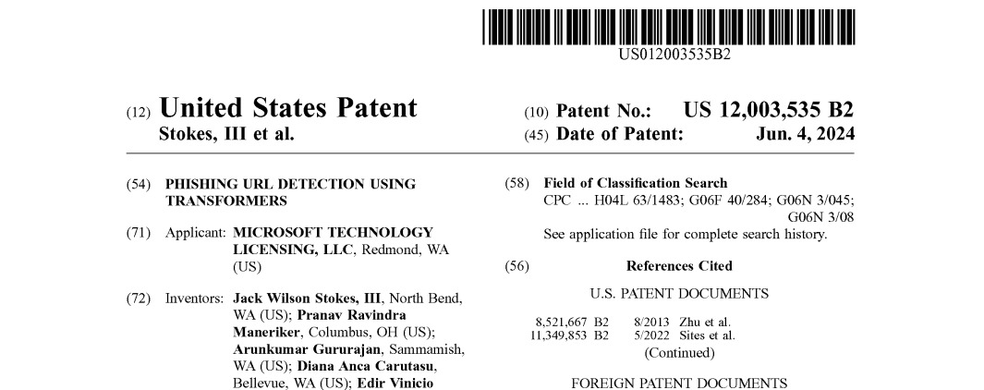
Patents
USING TRANSFORMERS
Patent No.: US012003535B2
Patent Title: PHISHING URL DETECTION USING TRANSFORMERS
Source: https://ppubs.uspto.gov/dirsearch-public/print/downloadPdf/12003535
Methodology:
URL Tran-detects malicious URLs by using transformer models
Creates a decision statistic (uses BPE(byte pair encoding) + an ML model )

Slide 10
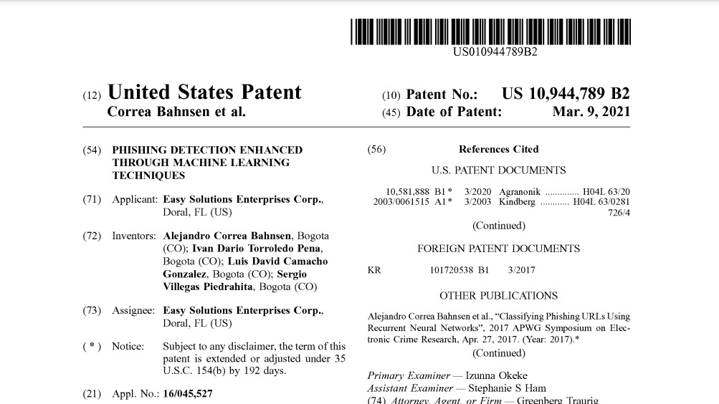
Patents
USING ML
Patent No.: USO10944789B2
Patent Title: PHISHING DETECTION ENHANCED THROUGH MACHINE LEARNING TECHNIQUES
Source: https://ppubs.uspto.gov/dirsearch-public/print/downloadPdf/10944789
Methodology:
This approach involves generating synthetic URLs
These URLs are given to LSTM to classify whether given URL is malicious or not.

Slide 11
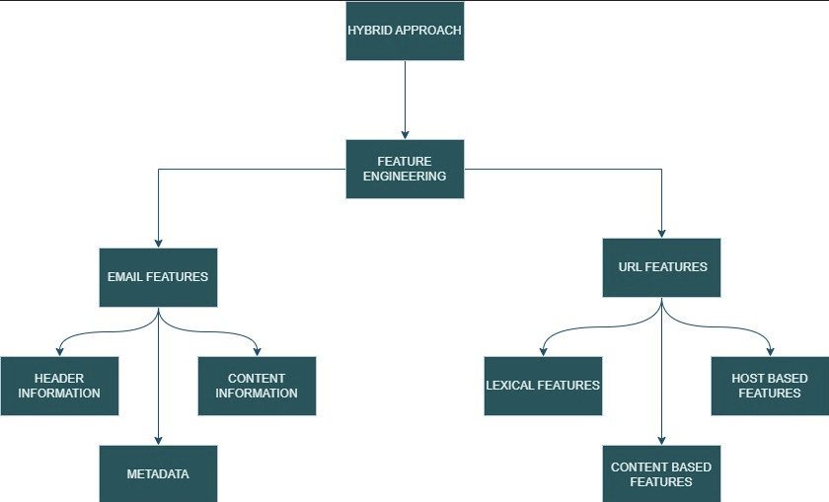

Our Approach
Hybrid Approach

Slide 12

Our Approach
Feature Analysis
URL Analysis
1
3
Feature analysis model accurately detect and classify phishing attempts
Email Analysis
URL Analysis
The URL analysis can be categorised into 2 main types: Lexical Analysis, Host-based Analysis
Email Analysis
Lexical Analysis
2
4
The CNN is used to extract the n-grams while the LSTM is responsible for retaining the dependencies and features. The key features analysed in email analysis are
Header Analysis
Textual Analysis
Lexical Analysis is the analysis of the structure of the URL. Lexical Analysis generally include analysis of the following features of a URL:
1.URL Length 2.Domain and URL entropy 3.Suspicious and high weighted keywords 4.Number of Tokens 5.Digit Count

Slide 13
Our Approach
Host-based Analysis
Updating Datalogs
5
6
Host-based analysis focuses on analysing the information about the URL domain itself. This feature is used to further assessing the legitimacy of the URL. It includes the following:
Domain Look-up: Open-source platforms – WHOIS Lookup is used to obtain information about the Domain’s Geo-location, Domain Age, Domain Expiration, Registrar information.
Integrating Phishtank and Openphish API to access the data logs and the blacklist records
Automating the development of a viable datalog with different data ensures that the url is flagged

Slide 14
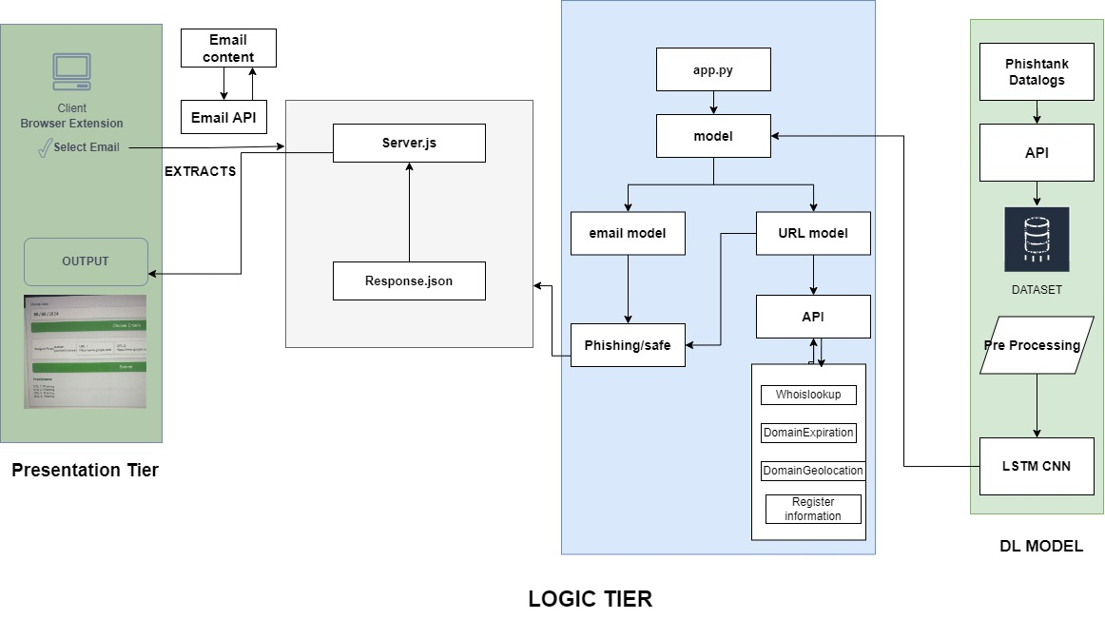
Architecture
ARCHITECTURE

Slide 15
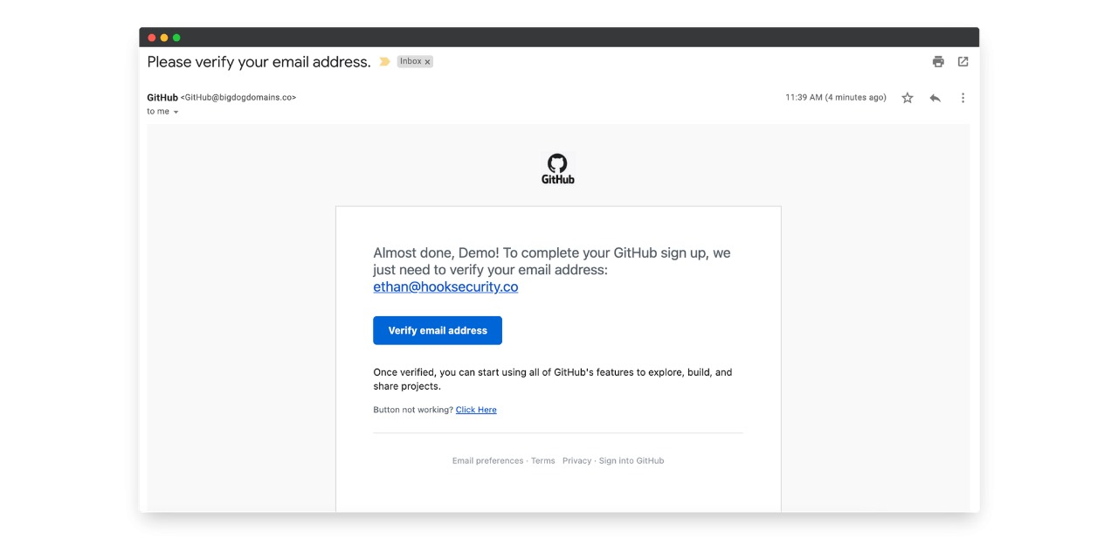
Header Analysis
Content Analysis
URL Analysis
URL Analysis
Lexical Analysis
Host based Analysis

Slide 16
Progress
MILESTONES ACHIEVED SO FAR
Patents
Datasets
Went through various patents and gained knowledge of various approaches .
Patents link
Collection of various datasets related to Phishing
Datasets Link
01
02
03
04
05
Research
Market
Updating Datalogs
Explored the existing models and approaches.
Research Papers link
Knowing the market and the need of Phishing detection tools.
Market Report
Integrating Phishtank and Openphish API to access the data logs

Slide 17
Progress
MILESTONES ACHIEVED SO FAR
Lexical Analysis
Extraction
URL analysis using LSTM+CNN
Extraction of email for a particular date and subject
06
07
08
09
10
08
09
Host Based features
Email Analysis
Extension
Email analysis using LSTM+CNN
Working of an user extension
Integration of API’s of Whois Lookup
Link for all the research papers, patents, datasets.

Slide 18
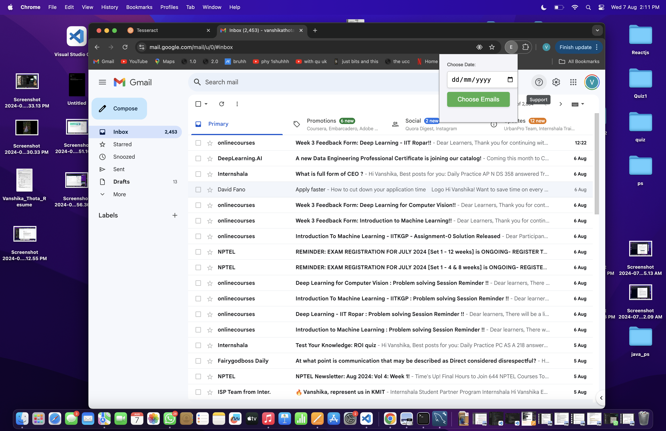
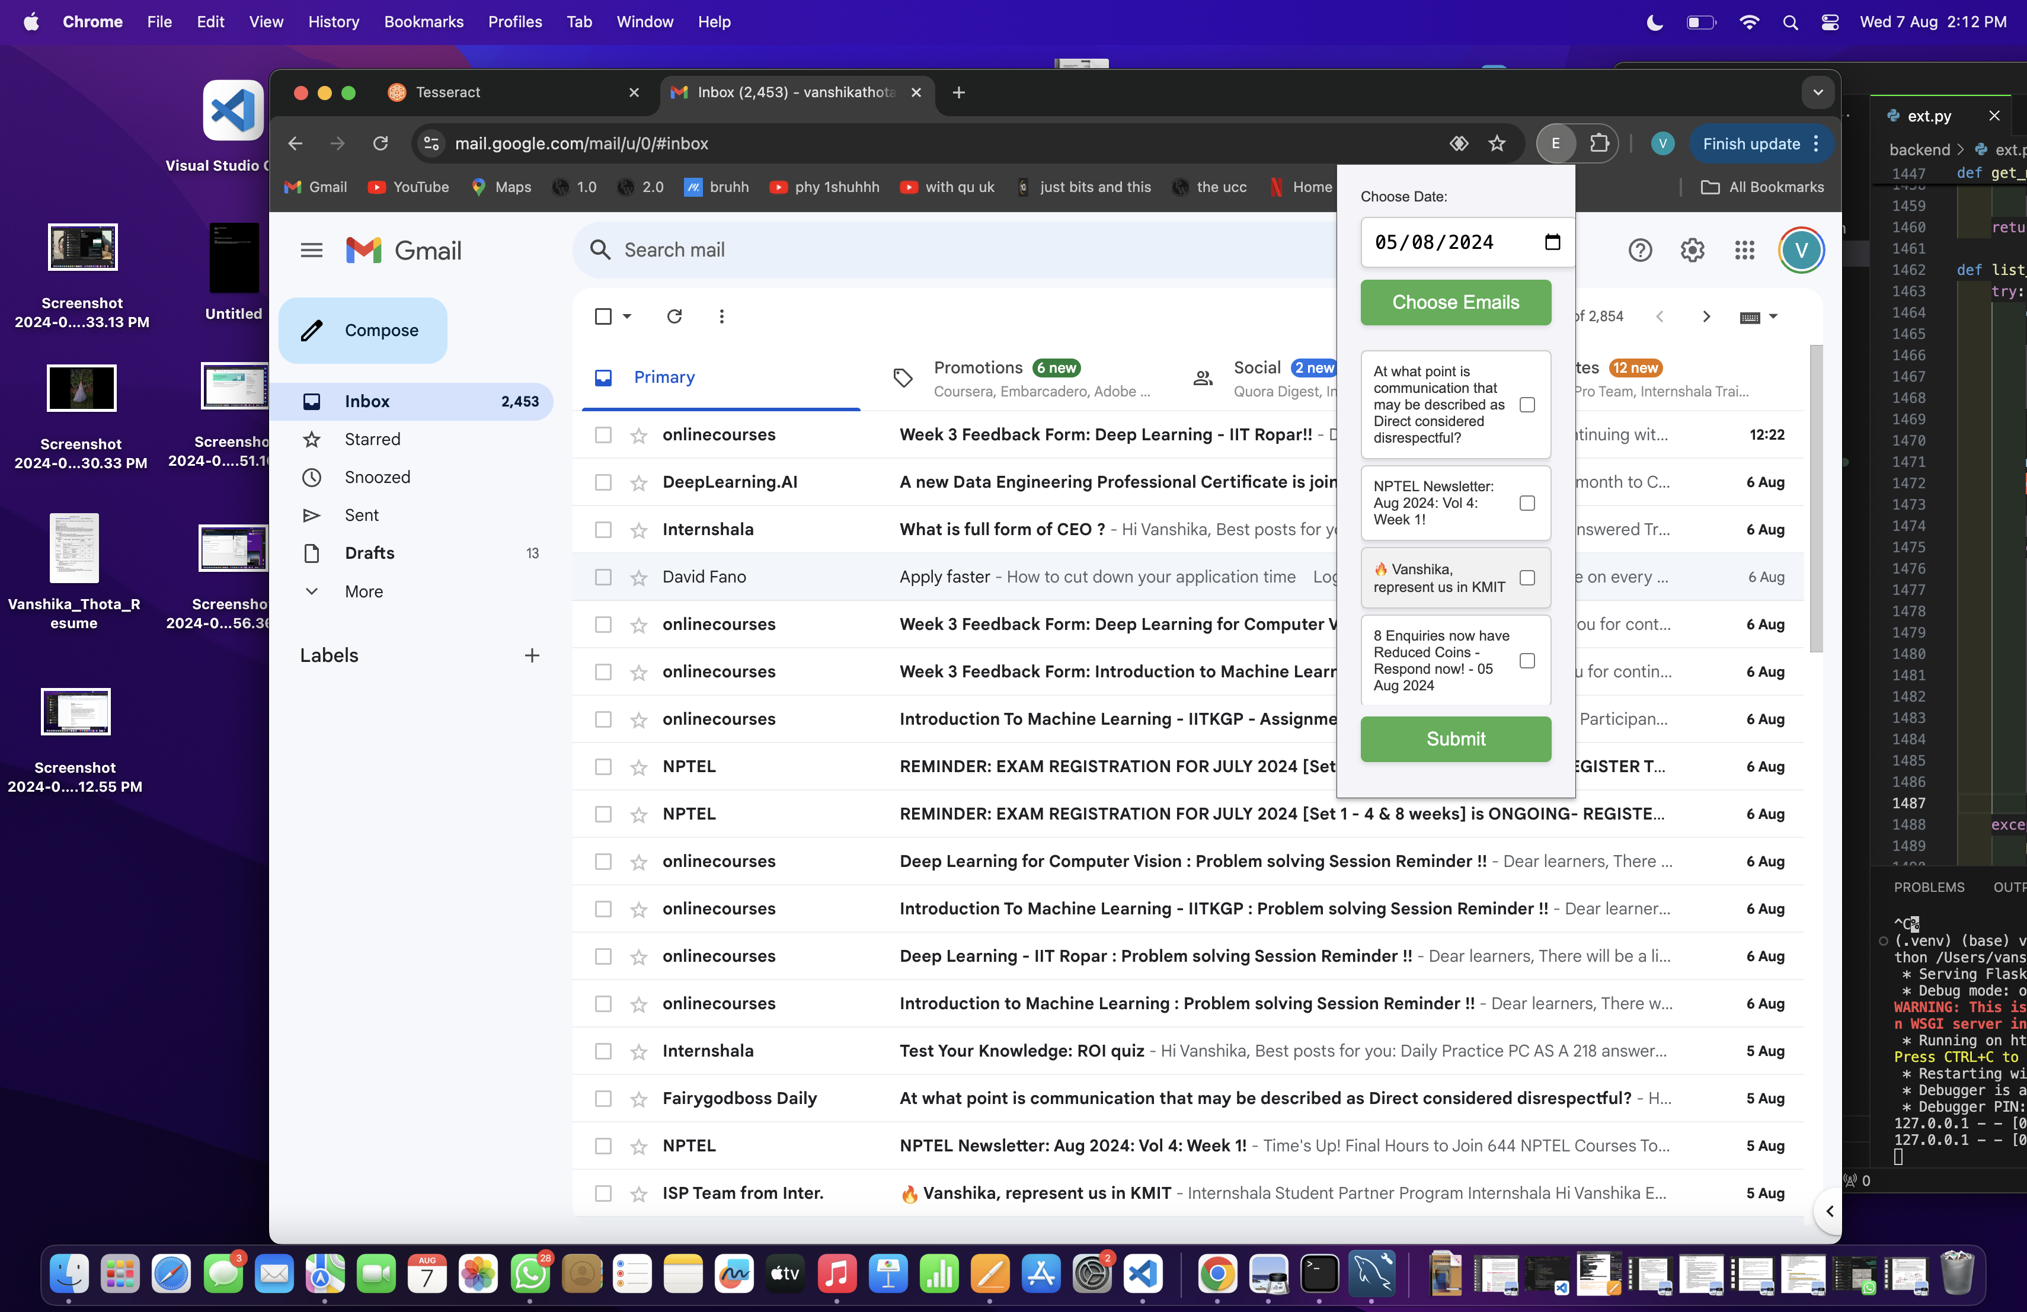
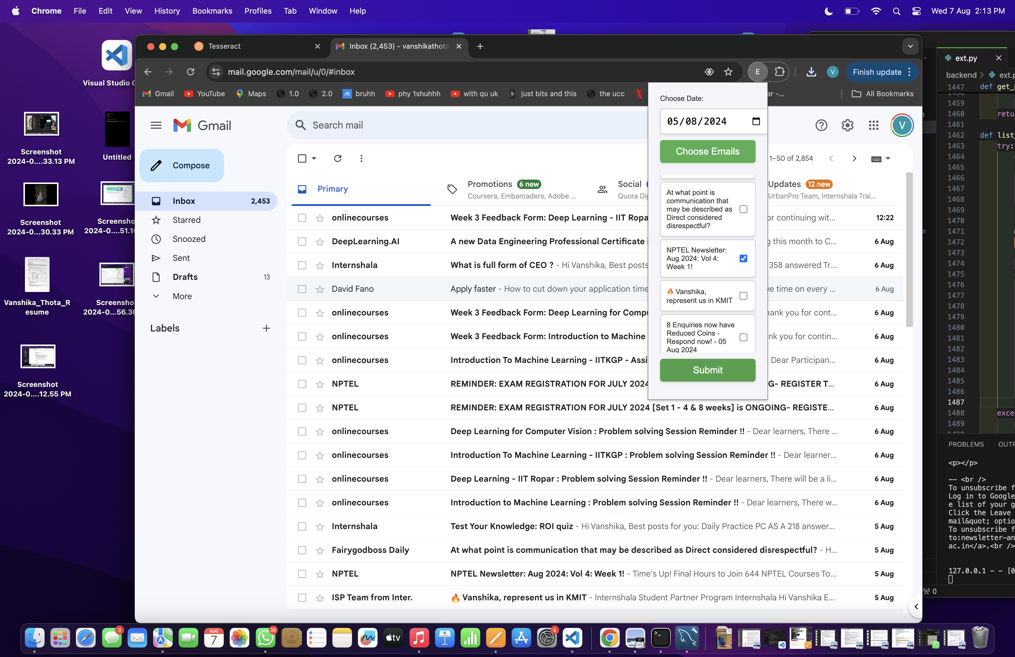
Extension

Slide 19
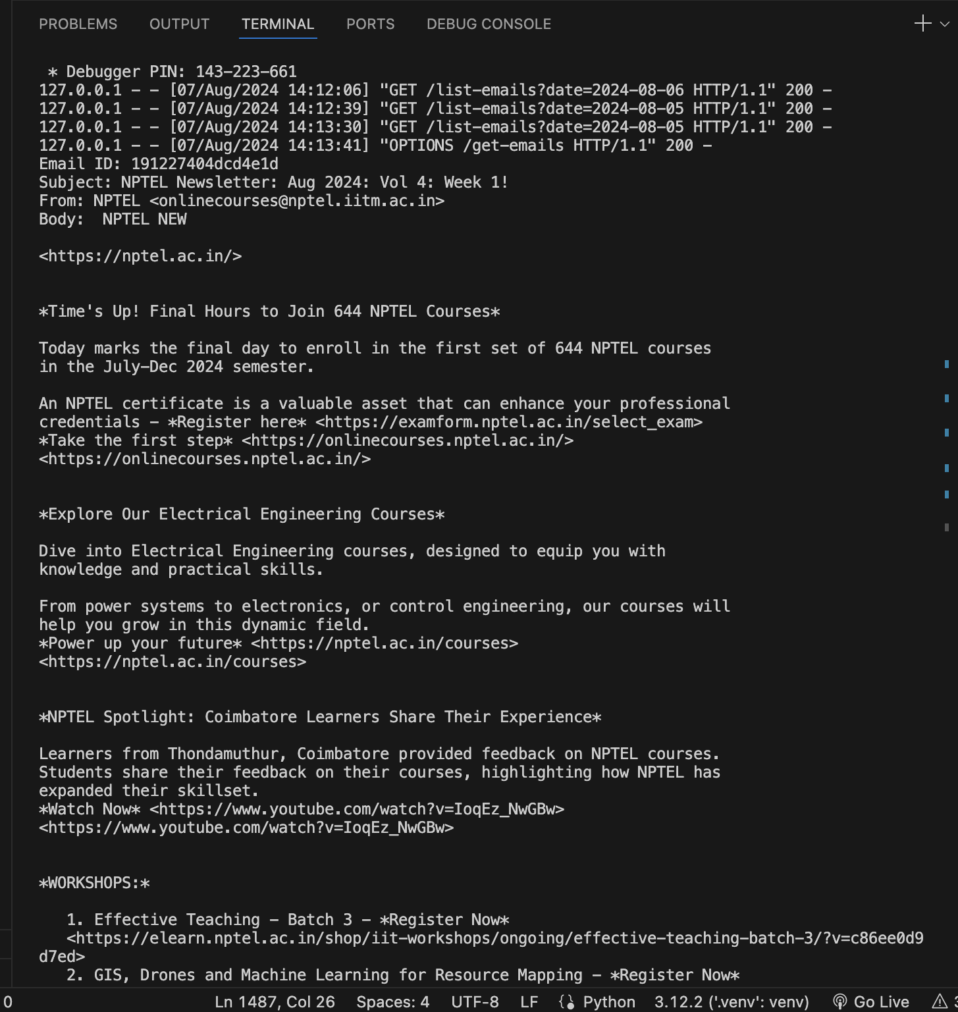
Extraction

Slide 20
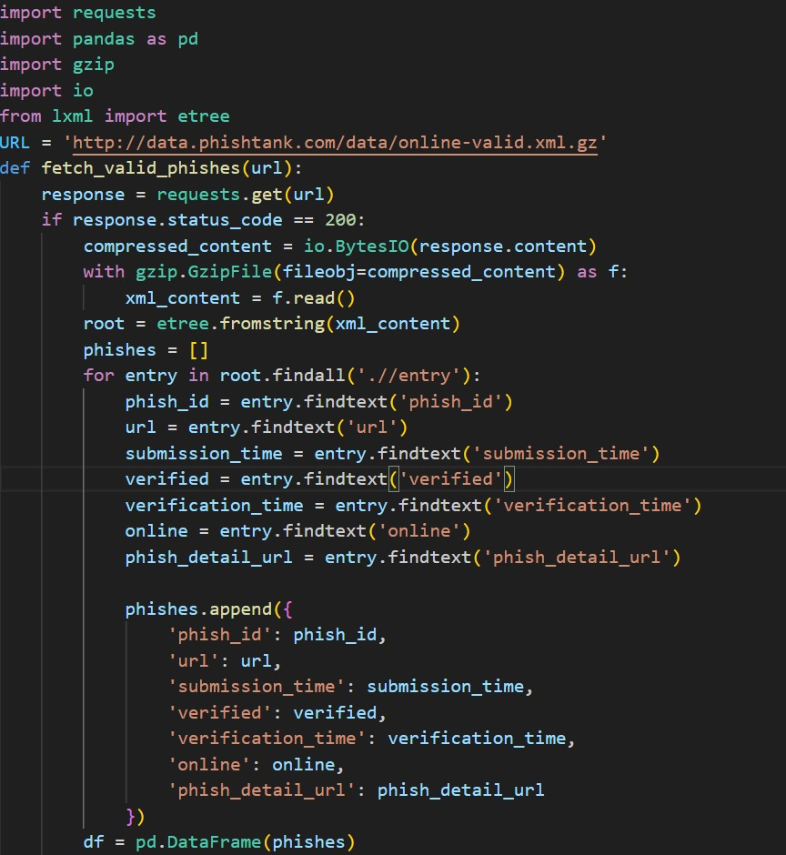
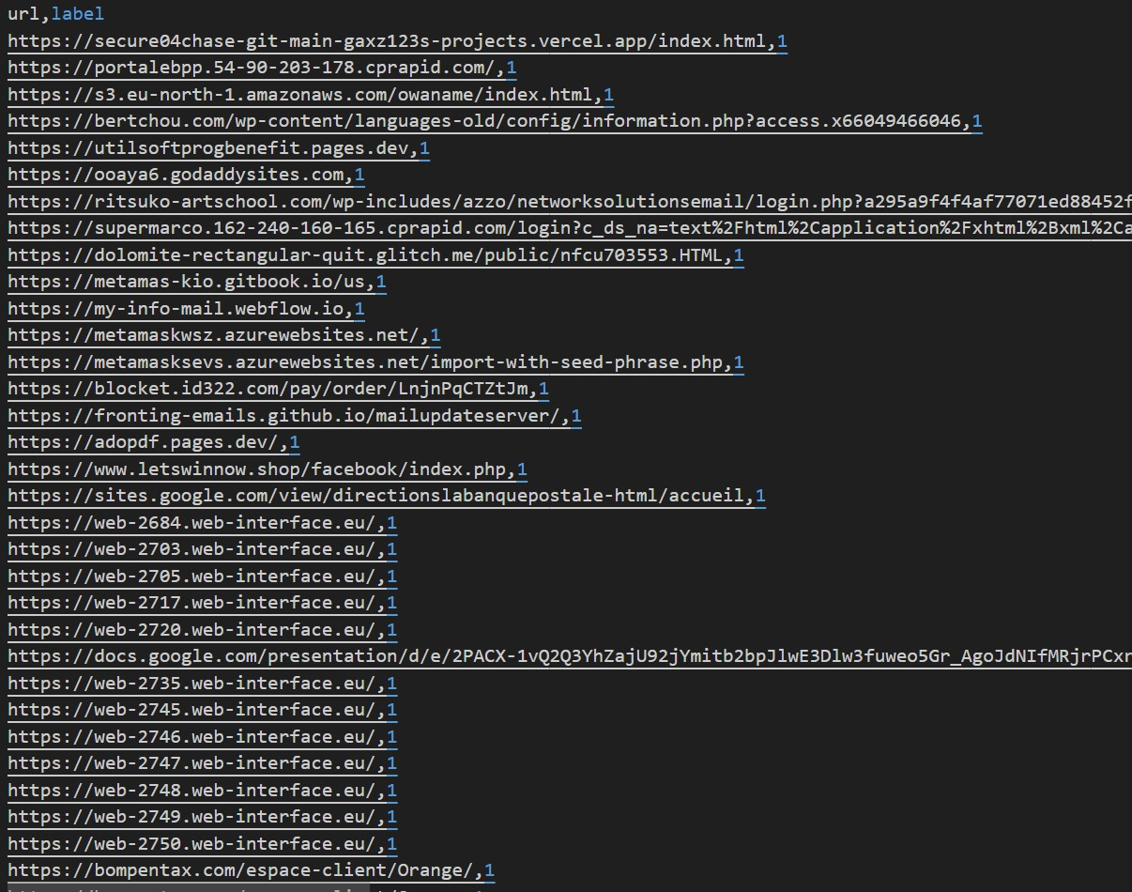
Updating Datasets
Created Dataset
Automating updation of datasets

Slide 21
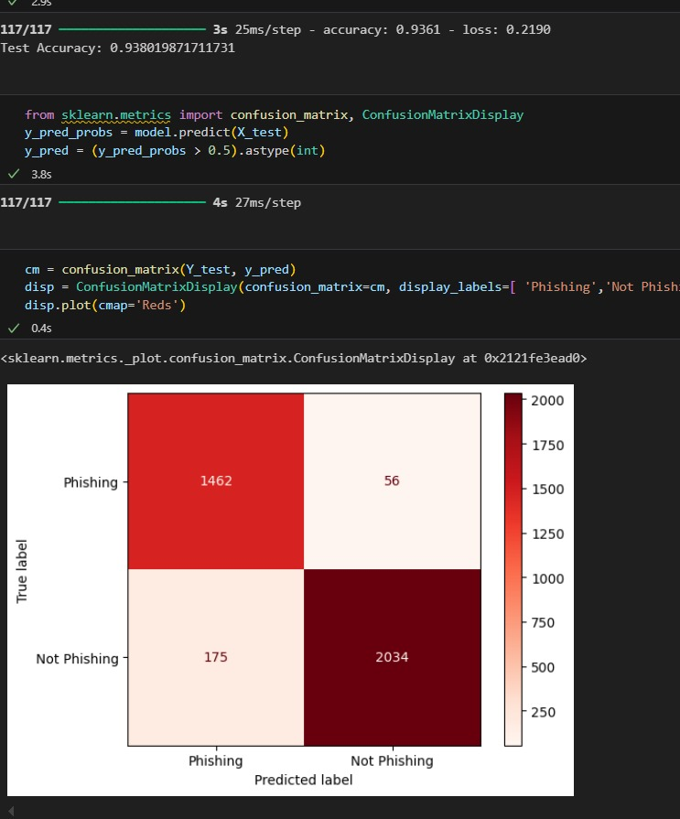
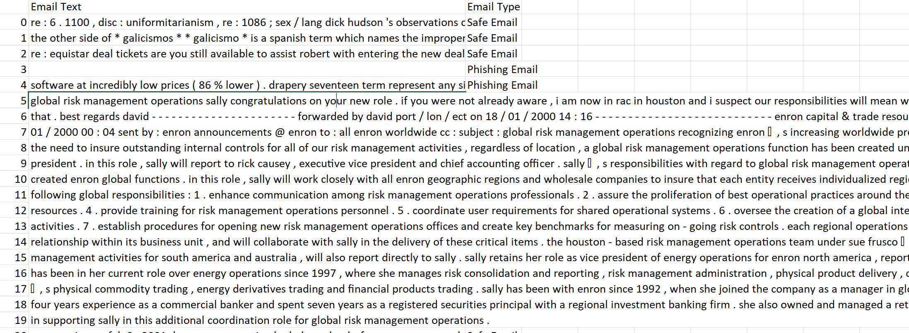
Email Analysis
Dataset from Kaggle
Dataset Link
Using LSTM and CNN
Accuracy of 95.6

Slide 22
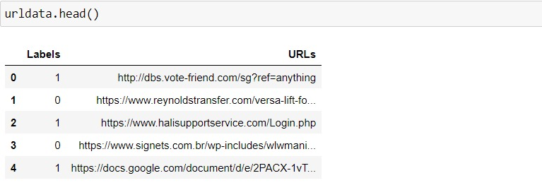
URL Analysis
LEXICAL FEATURES
Using LSTM & CNN
Accuracy of 98.1
Customized dataset from Phishtank

Slide 23
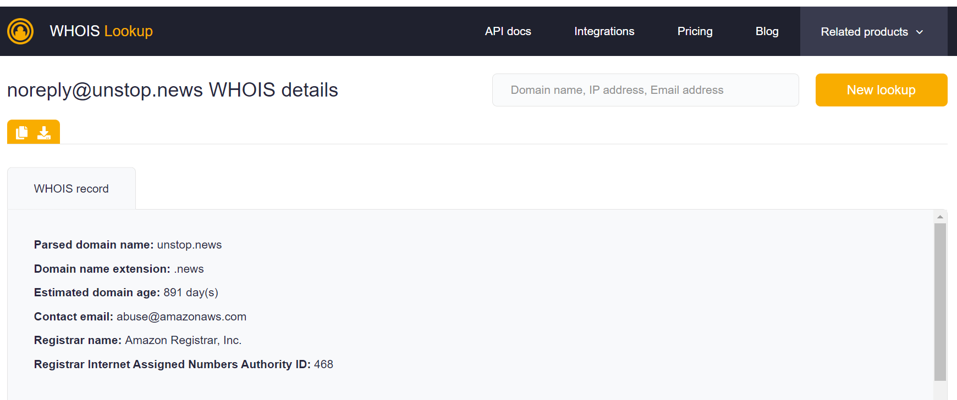
URL Analysis
HOST BASED FEATURES
Whois lookup API integration
Domain Name
Creation Date
Expiration Date
City
State
Country

Slide 24
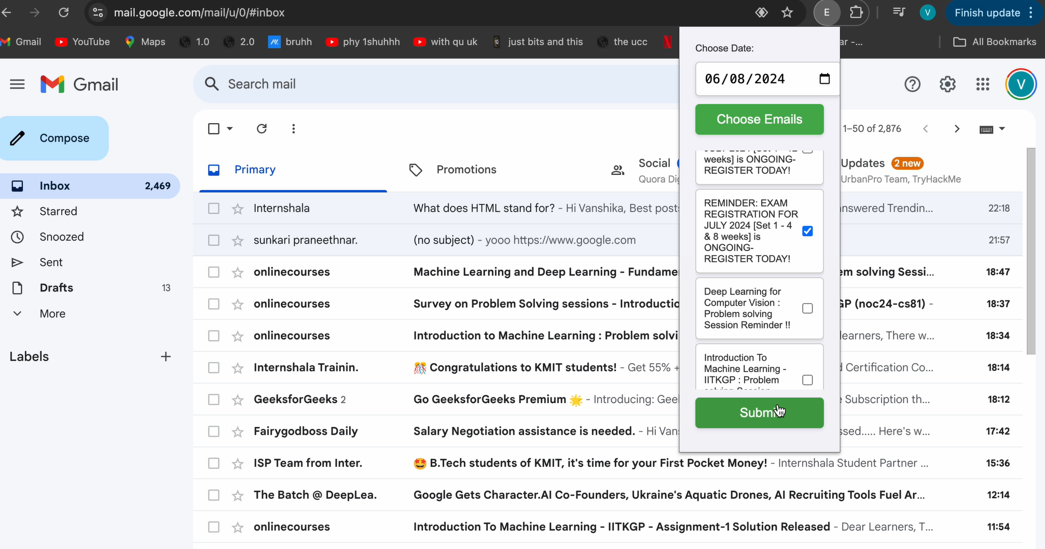
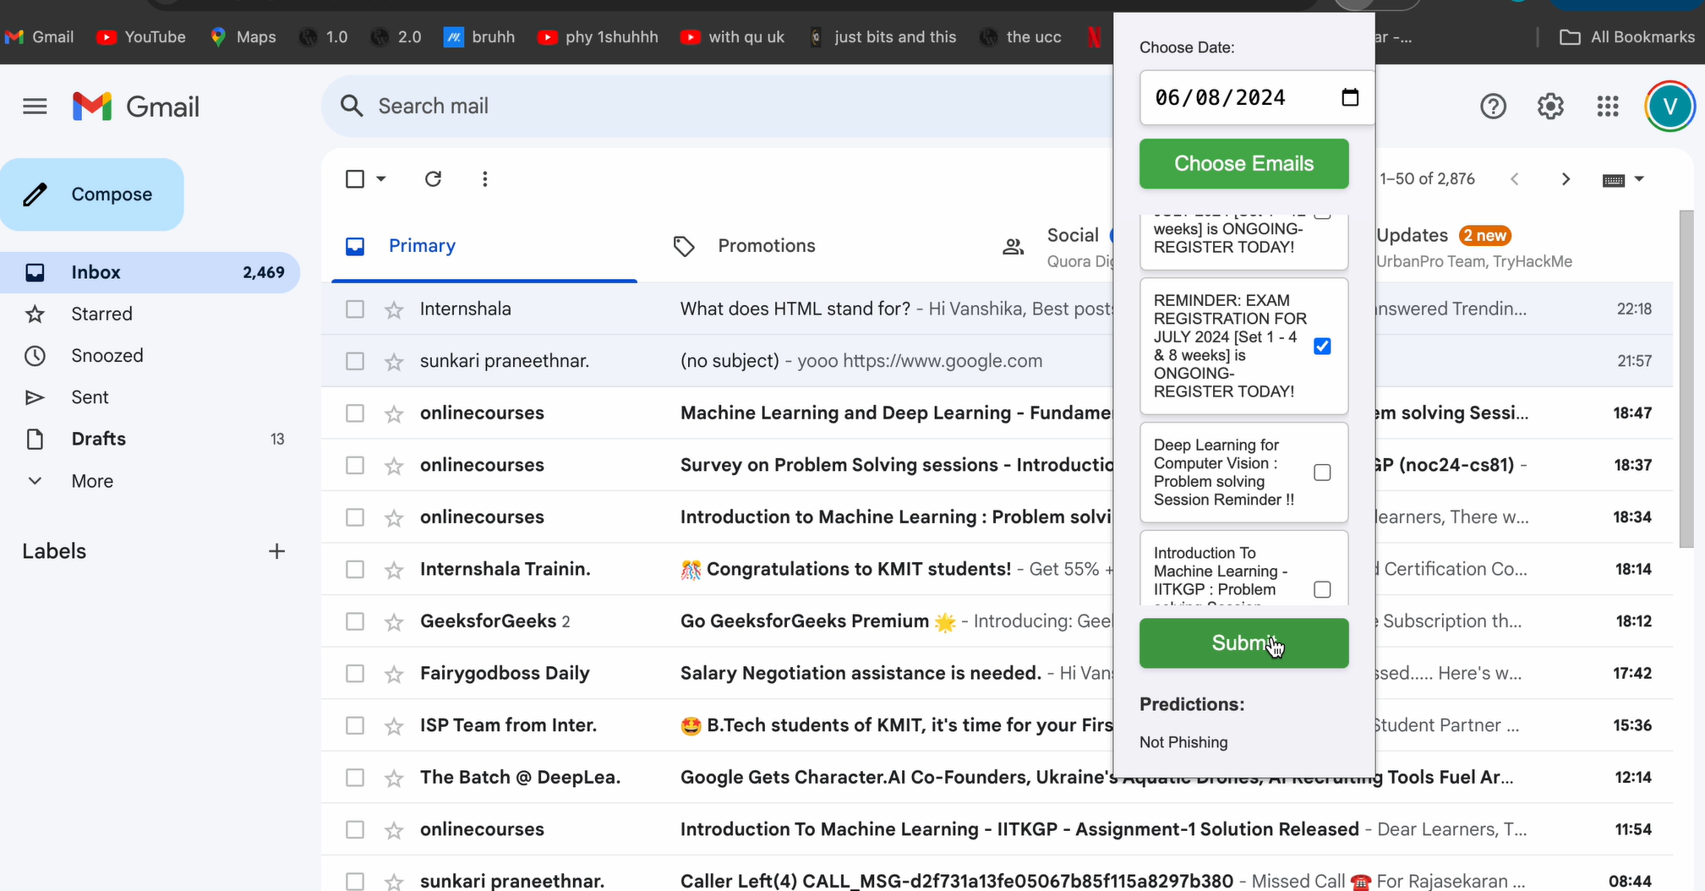
Working of Extension
User selects the required Emails
Shows if the email is Phishing or not

Slide 25
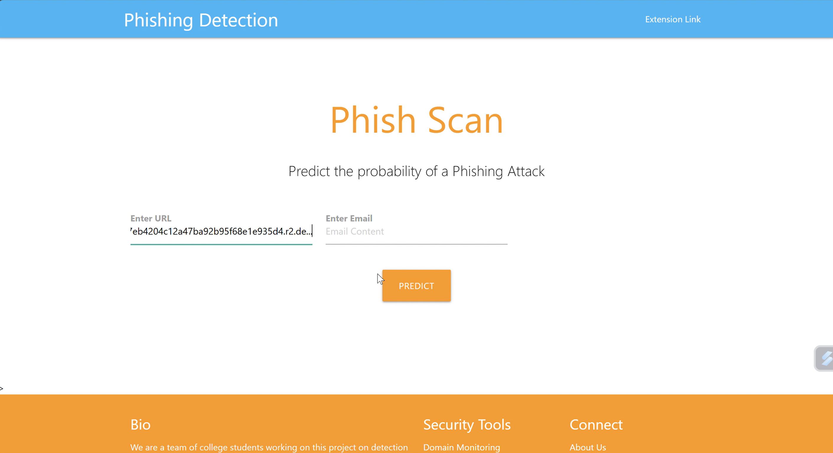
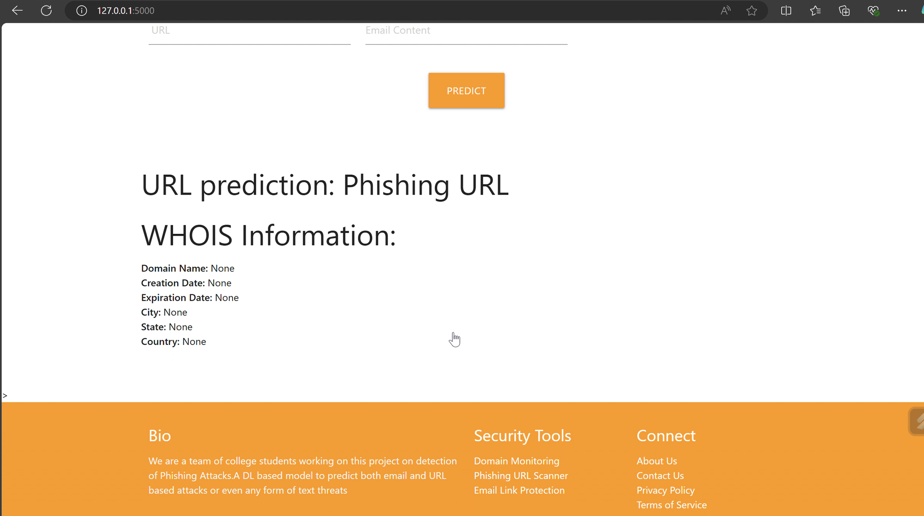
Working of Website
Shows if it is safe or phishing along with whois information
User Enters the input

Slide 26







Advantages of this approach
Automatic Extraction
Updating Datasets
Detect trends
Enhanced security
The automated extraction releases the burden from users
Anomaly Detection
Betterment of the model with time
Detects Phishing attacks and thereby decreases security threats
User friendly
Detection
Optimal efficiency
Accuracy
Easy to use extension
Works on both emails and URLs
Increases the likelihood of a better structure using a multi model system
Good accuracy model for correct detection of Phishing attacks

Slide 27
Future Work
Content based analysis
Adding features for extension and Web Application
02
04
01
03
Model Fine tuning
Integration of models and API

Slide 28
Phishing Detection
THANK YOU
ANY QUERIES ?

